Slide 1
Bank Management System
Name :- Khushi Bansal
Name: Ashwini Malhari Dhumal

Slide 2
Software Interfaces
Development Tools: python
Database : MySQL
Software Tools: Anaconda(Spyder), MySQL workbench

Slide 3
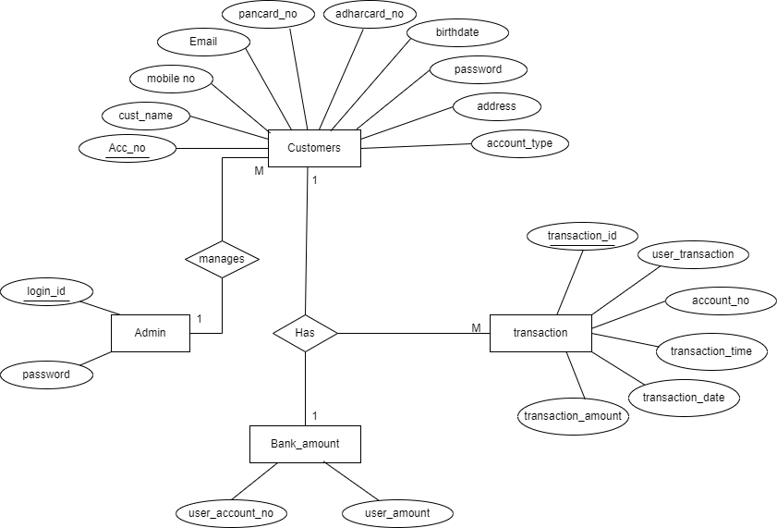
UML Diagrams ER-Diagram

Slide 4
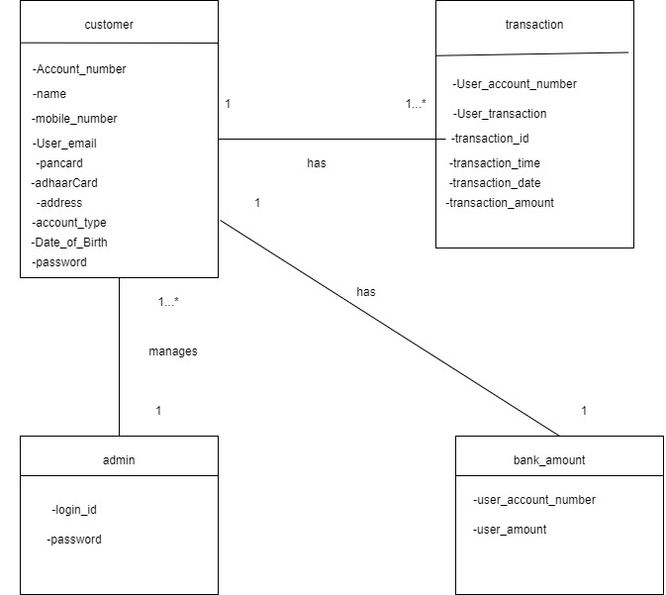
Class Diagram

Slide 5
Reports Of The Code In The Amdocs Bank .
Highest Balance In The Amdocs Bank .
Mini Statement In The Amdocs Bank .
Amount Deposited In Amdocs Bank .
Count Transaction According To The Date In The Amdocs Bank .

